Slide 1
Asset Management Portal
SlideMake.com

Slide 2
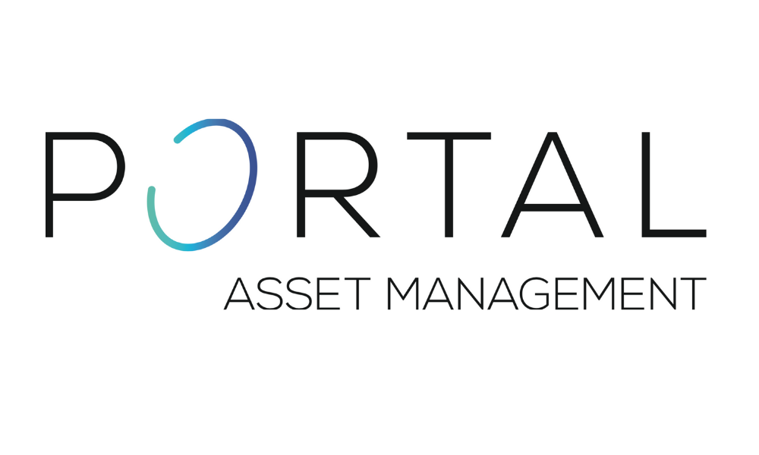
Introduction to Asset Management Portal
An asset management portal is a centralized platform used to track and manage organizational assets.
It streamlines processes related to asset lifecycle, including procurement, maintenance, and disposal.
The portal enhances transparency, efficiency, and decision-making across the organization.
Notes:
Image source: https://portal.am

Slide 3
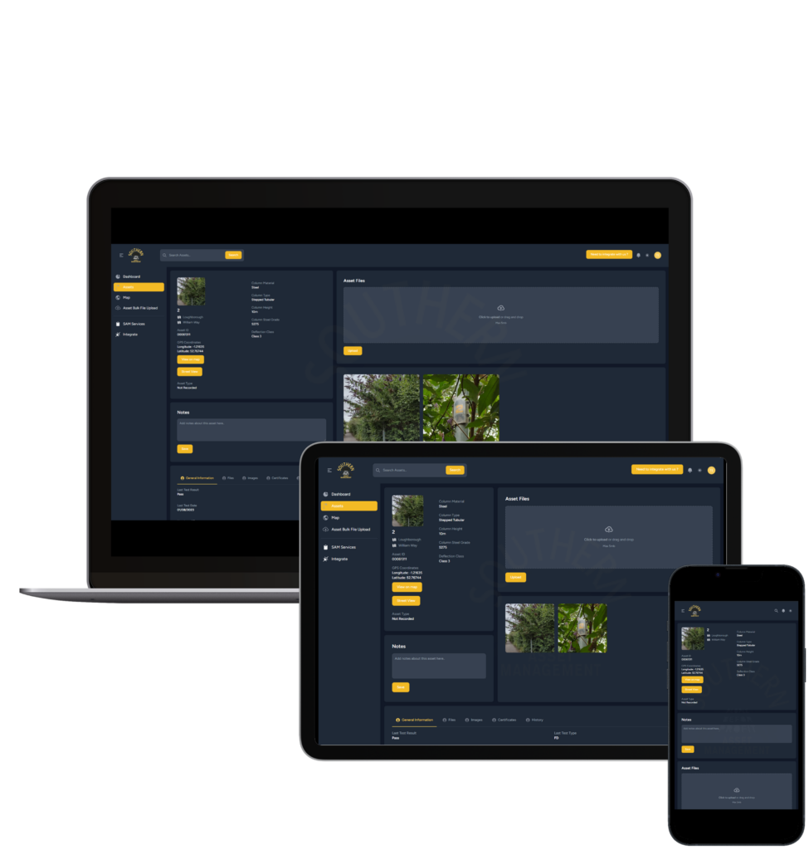
Key Features of an Asset Management Portal
Real-time asset tracking with detailed inventory information.
Automated maintenance scheduling and alerts to prevent downtime.
Reporting tools for performance analysis, compliance, and audits.
Notes:
Image source: https://southernassetmanagement.co.uk

Slide 4
Benefits of Using an Asset Management Portal
Improved asset utilization and reduced operational costs.
Increased accuracy in asset data and reduced manual errors.
Enhanced compliance with industry standards and regulatory requirements.
Notes:
Image source: https://southernassetmanagement.co.uk

Slide 5
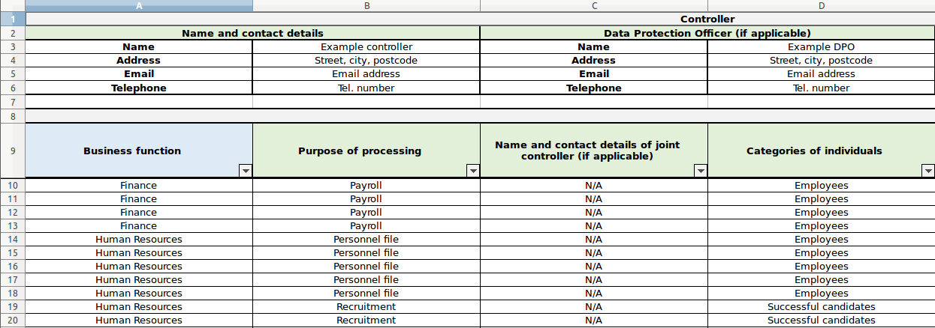
Core Modules of the Portal
Asset Register: Central repository for all asset information.
Maintenance Management: Scheduling, tracking, and recording maintenance activities.
Lifecycle Management: Monitoring asset depreciation, upgrades, and disposal.
Notes:
Image source: https://matomo.org

Slide 6
Implementation Best Practices
Conduct a thorough needs assessment to tailor the portal to organizational requirements.
Ensure seamless integration with existing enterprise systems such as ERP or finance software.
Provide comprehensive training and support to maximize user adoption.
Notes:
Image source: https://southernassetmanagement.co.uk

Slide 7
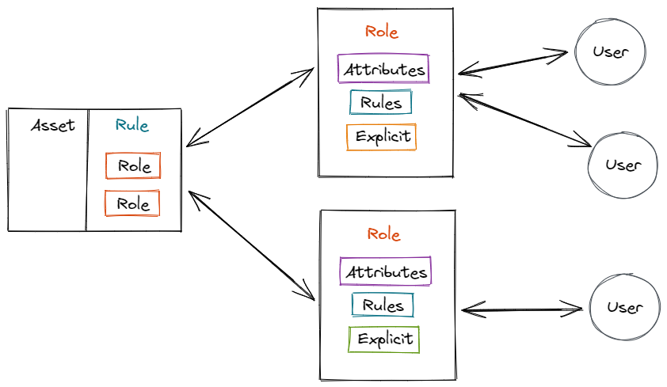
Security and Data Privacy Considerations
Implement role-based access controls to restrict sensitive data.
Regularly update security protocols to defend against cyber threats.
Maintain data backups and disaster recovery plans to ensure data integrity.
Notes:
Image source: https://www.atatus.com

Slide 8

Challenges in Asset Management Portal Deployment
Resistance to change from staff accustomed to manual processes.
Data migration complexities from legacy systems.
Ensuring continuous system updates and user support for optimal performance.
Notes:
Image source: https://www.slidemake.com

Slide 9

Future Trends in Asset Management Portals
Incorporation of IoT devices for real-time asset monitoring.
Use of AI and analytics for predictive maintenance and decision support.
Deployment of mobile applications for on-the-go asset management.
Notes:
Image source: https://cdn.iplocation.net

Slide 10
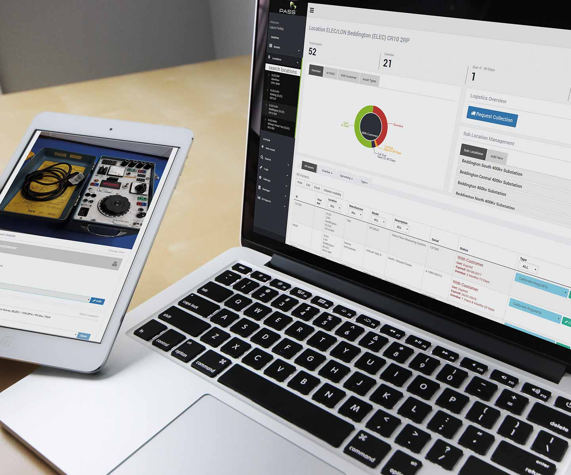
Case Study: Successful Implementation
Organization X reduced asset downtime by 30% using the portal.
They achieved a 20% decrease in maintenance costs within the first year.
Employee satisfaction improved due to streamlined asset management processes.
Notes:
Image source: https://www.calibrate.co.uk

Slide 11
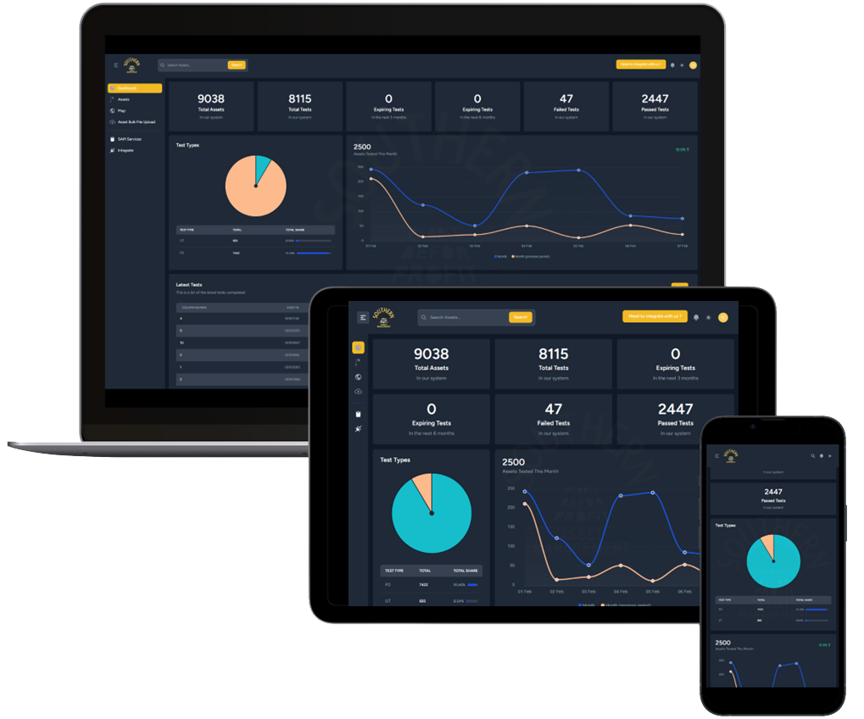
Conclusion and Next Steps
An asset management portal is essential for modern organizations aiming for efficiency.
Proper planning and implementation are key to maximizing its benefits.
Organizations should regularly review and upgrade the portal to adapt to evolving needs.
Notes:
Image source: https://southernassetmanagement.co.uk

